Slide 2
Building Resilient Microservices with .NET Core and Azure Container Services (AKS)
Glenn Condron
Program Manager – ASP.NET
@condrong
Steve Lasker
Program Manager – Azure Developer Experiences
@stevelasker
BRK2141
Notes:
Building Resilient Microservices with .NET Core and Azure Container Services (AKS)
Code: BRK2141
Type: Breakout 45 minute
Track(s): Applications and Infrastructure
Speaker(s): Glenn Condron, Steve Lasker
Timeslot: Monday, May 7 2:45 PM-3:30 PM
Abstract:Microservices are highly scalable, resilient, and composable units of deployment for modern applications. But building them is hard. There are a lot of development and deployment considerations to take into account. In this session we'll show you how we're making .NET Core microservices easier to build with new application patterns in .NET Core 2.1 as well as how to deploy and manage them with Kubernetes and Helm.

Slide 3
Abstract:Microservices are highly scalable, resilient, and composable units of deployment for modern applications. But building them is hard. There are a lot of development and deployment considerations to take into account. In this session we'll show you how we're making .NET Core microservices easier to build with new application patterns in .NET Core 2.1 as well as how to deploy and manage them with Kubernetes and Helm

Slide 4
Abstract
Building Reliable Systems
What makes a system reliable?
Pics/Animation of forms of reliability – what people do
Patterns of reliability
Developing for services that aren’t critical or cable of being 100% reliable
Developing for services that must be available 100%
How Containers can make your service 100% reliable
Why Microservices – is it just the latest fad?
Why microservices enable reliability
No individual service can be 100% reliable
How .NET Core enables reliability
How you can build reliable systems on top of unreliable things

Slide 5
What Makes a System Reliable?
Are individual components 100% reliable?
Is power 100% reliable?
Is network connectivity 100% reliable?
Is the OS and/or Framework 100% reliable?
Is your code 100% reliable?
Does it need to be 100% reliable?

Slide 6
Failure Is A Thing
If you assume things will fail, you’re prepared for reality
It’s not a matter of avoiding failure, it’s preparing for what to do when things fail
Building reliable systems embraces failure and provides for alternative paths

Slide 7
Balancing the “Cost” of Reliability
What are “costs”?
How much code are you willing to write
How many redundant instances will you pay for?
How many regions should you deploy to
, test
, maintain?
, and pay for?

Slide 8
Can You Answer These Questions?
What if that that service didn’t work for _____ amount of time?
Would your customer be able to complete the important task?
Should the whole system fail because one minor piece failed?

Slide 9
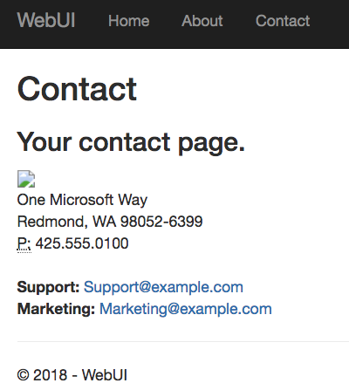
What’s the most basic fault-tolerant feature of HTML?
HTTP 404 - Broken Image

Slide 10
What has changed, in this wave of technology?
Container Orchestration – designed with failure as a design principal
Microservices – Smaller, isolated, idempotent units of capability

Slide 11
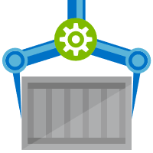


Computing That Assumes Failure As the Norm
Release Management
Resource Pool
Orchestration
HOST-A
Deploy:
web:1 x3
api:1 x3
cache:1 x4
Image Cache
3
web:1
digest: 91e
web:1
digest: 91e
Foo:
web:1 x3
api:1 x3
cache:1 x4
web:1
digest: 91e
api:1
digest: u82
Container Builder
cache:1
digest: 2re
cache:1
digest: 2re
Container Registry
HOST-B
Image Cache
api:1
digest: u82
api:1
digest: u82
7
6
api:1
digest: u82
5
web:1
digest: 91e
api:1
digest: u82
cache:1
digest: 2re
api:1
digest: u82
cache:1
digest: 2re
1
cache:1
digest: 2re
docker build –t web:1
docker build –t api:1
docker build –t cache:1
docker push web:1
docker push api:1
docker push cache:1
cache:1
digest: 2re
cache:1
digest: 2re
Image
web:1
api:1
cache:1
2
Digests
91e
u82
2re
web:1
digest: 91e
HOST-C
api:1
digest: u82
4
cache:1
digest: 2re
8
Image Cache
api:1
digest: u82
api:1
digest: u82
cache:1
digest: 2re
cache:1
digest: 2re
Notes:
Orchestrator icon from: http://cdn.marketplaceimages.windowsphone.com/v8/images/f58edb21-b20c-4315-b837-6cee21n442cd?imageType=ws_icon_large
https://git-scm.com/book/en/v2/Git-Branching-Basic-Branching-and-Merging

Slide 12
Microservice Resiliency
Coding for failure…
Retries – because there will be failures
Timeouts – as it may take longer than your users will wait
Circuit Breakers – so you don’t overload the system
Message Queues – to complete the user task quickly, finish up later

Slide 13


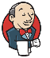
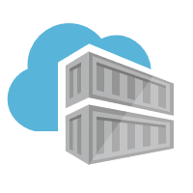
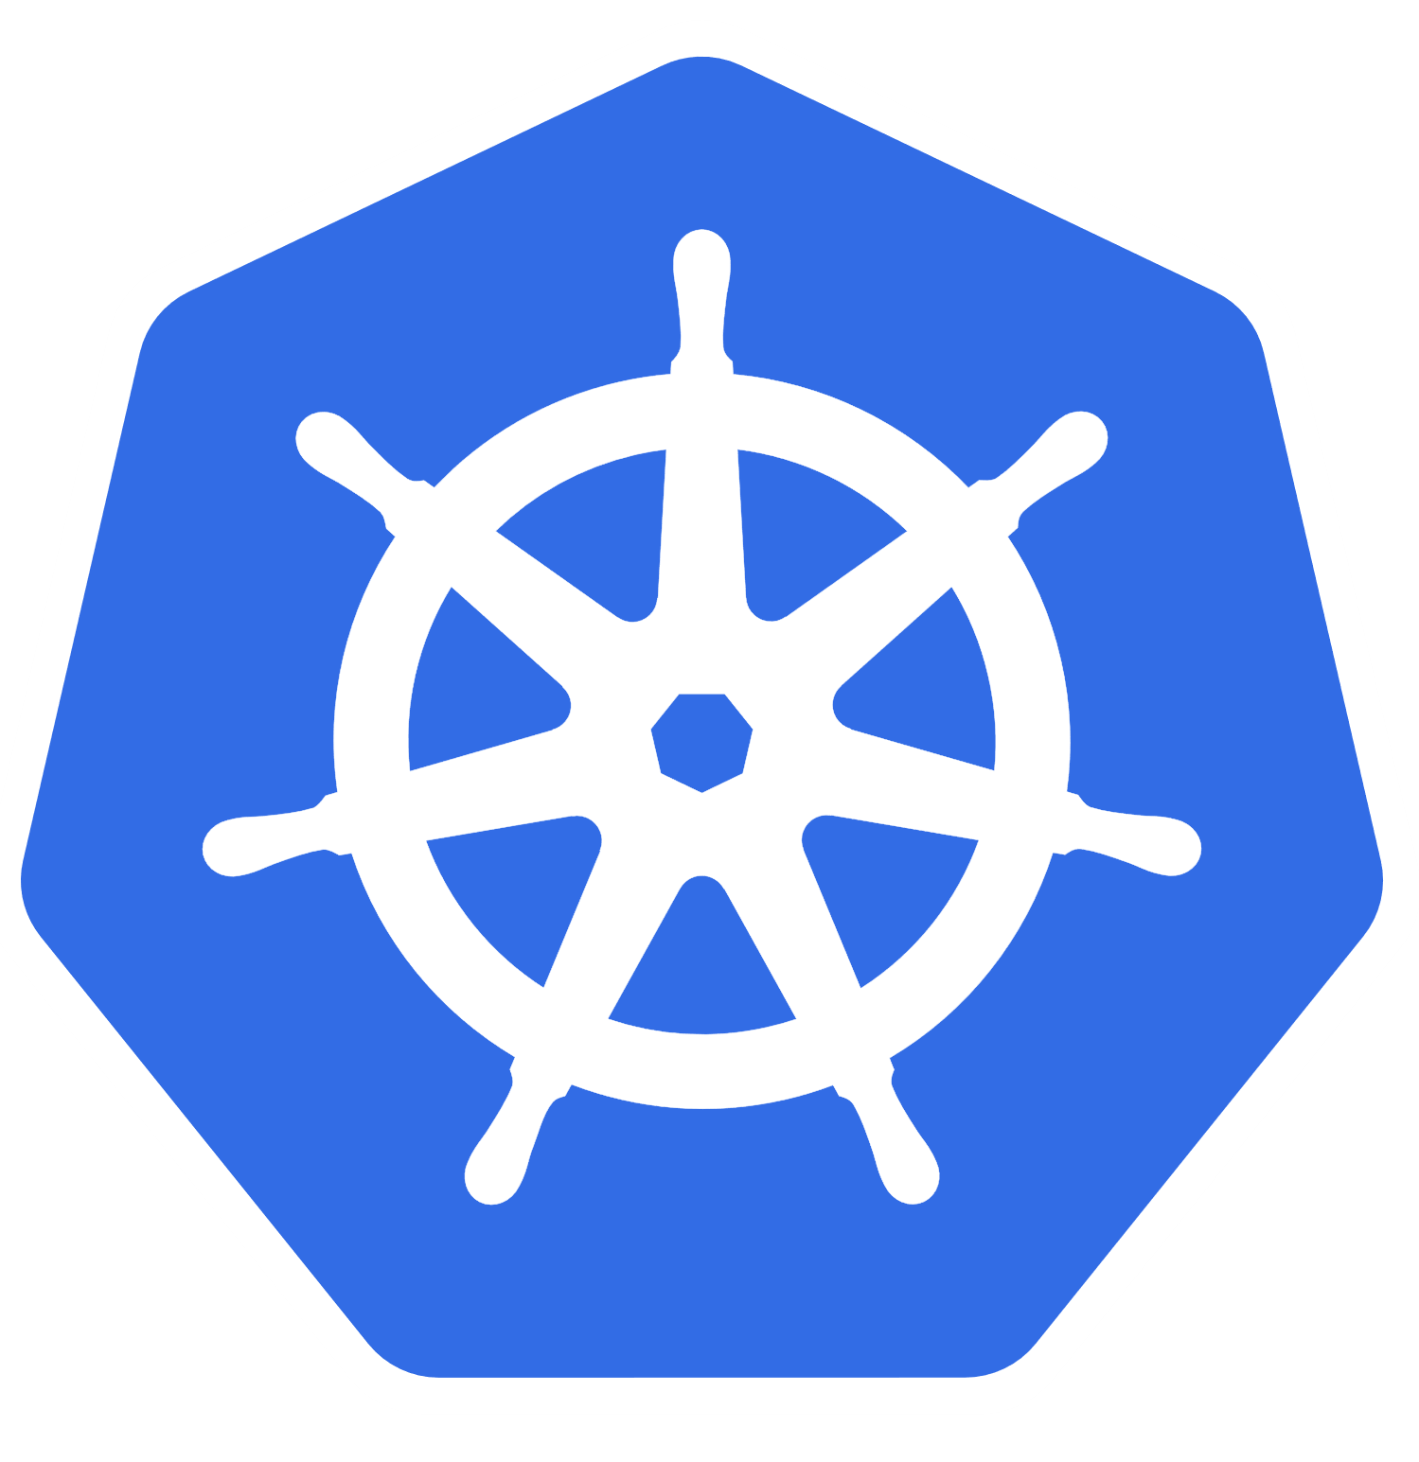


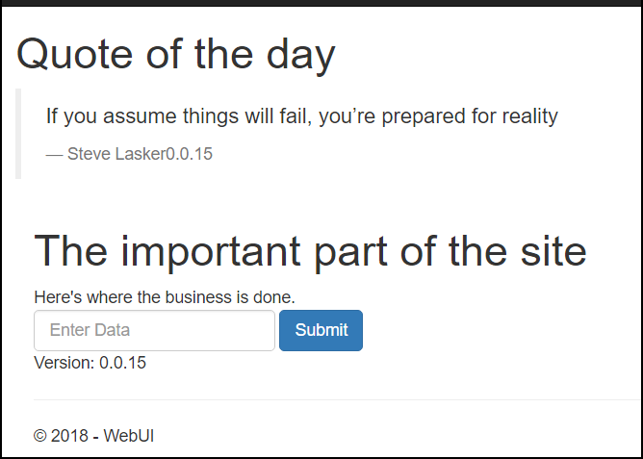
Demo Architecture
web
web
quotes -api
Important -api
/Demo
quotes -api
Important -api
ACR Build
ACR
East US
Important System
web
quotes-api
important-api
Important System

Slide 14
Demo
.NET Core 2.1
Coding for Failure

Slide 15
Demo Architecture
web
web
quotes -api
Important -api
/Demo
quotes -api
Important -api
ACR Build
ACR
Important System
web
quotes-api
important-api
Important System

Slide 16

Demo Architecture
ACR jengademos.azurecr.io
Geo-replicated
web
web
quotes -api
queue- worker
/Demo
quotes -api
queue- worker
ACR Build
East US
Important System
web
web
web
quotes-api
queue-worker
quotes -api
queue- worker
quotes -api
queue- worker
Important System
West Europe

Slide 17
Coming into port…
Building 100% reliability is like chasing chickens
Just when you think you’ve got one, 4 more show up
Just accept failure as the norm, and you’ll sleep well at night
Use the modern tools and technologies
“Containers are the unreliable service” packaging format
Orchestrators (Kubernetes) are your nighttime managers
Take the time to fully adapt to container first programming – this is a paradigm shift
.NET Core 2.1 provides coding for the “unreliable pattern”

Slide 18
Specifics We’ve Demo’d
Retries – .NET Core ___ Class
Timeouts – as it may take longer than your users will wait
Circuit Breakers – Poly Class ___
Message Queues – Azure Storage Queue - .9999 SLA
Extract Configuration – config.AddKeyPerFile(configPath, true)
Kubernetes Secrets – keep your secrets… secret, but fast
State Management – support multiple nodes
services.AddDataProtection()
.PersistKeysToAzureBlobStorage(GetBlobContainer(), "keys");

Slide 19
Related Breakout Sessions
.NET Platform
Visual Studio
Azure
Monday BRK2100 .NET Overview and Roadmap
Tuesday
BRK2151 What's new in Web Development with ASP.NET Core 2.1
BRK2147 Meet the new stack for real-time web communication: ASP.NET Core SignalR
BRK2155 The Future of C#
Wednesday
BRK2144 Entity Framework Core 2.1: Simple, Powerful Data Access for .NET
Monday
BRK2134 The Present and Not-too-distant Future of Visual Studio
BRK2152 What's new with Visual Studio for Mac
Wednesday
BRK2145 Get in the Zone: Visual Studio 2017 Productivity Enhancements
BRK2148 Supercharge your debugging in Visual Studio 2017
Tuesday
BRK2115 Building, Running, Patching Docker Containers – The Paradigm Shift
BRK2117 Diagnosing and debugging live cloud applications
Wednesday
BRK3810 Modernizing existing .NET applications with Windows Containers and Azure cloud

Slide 20
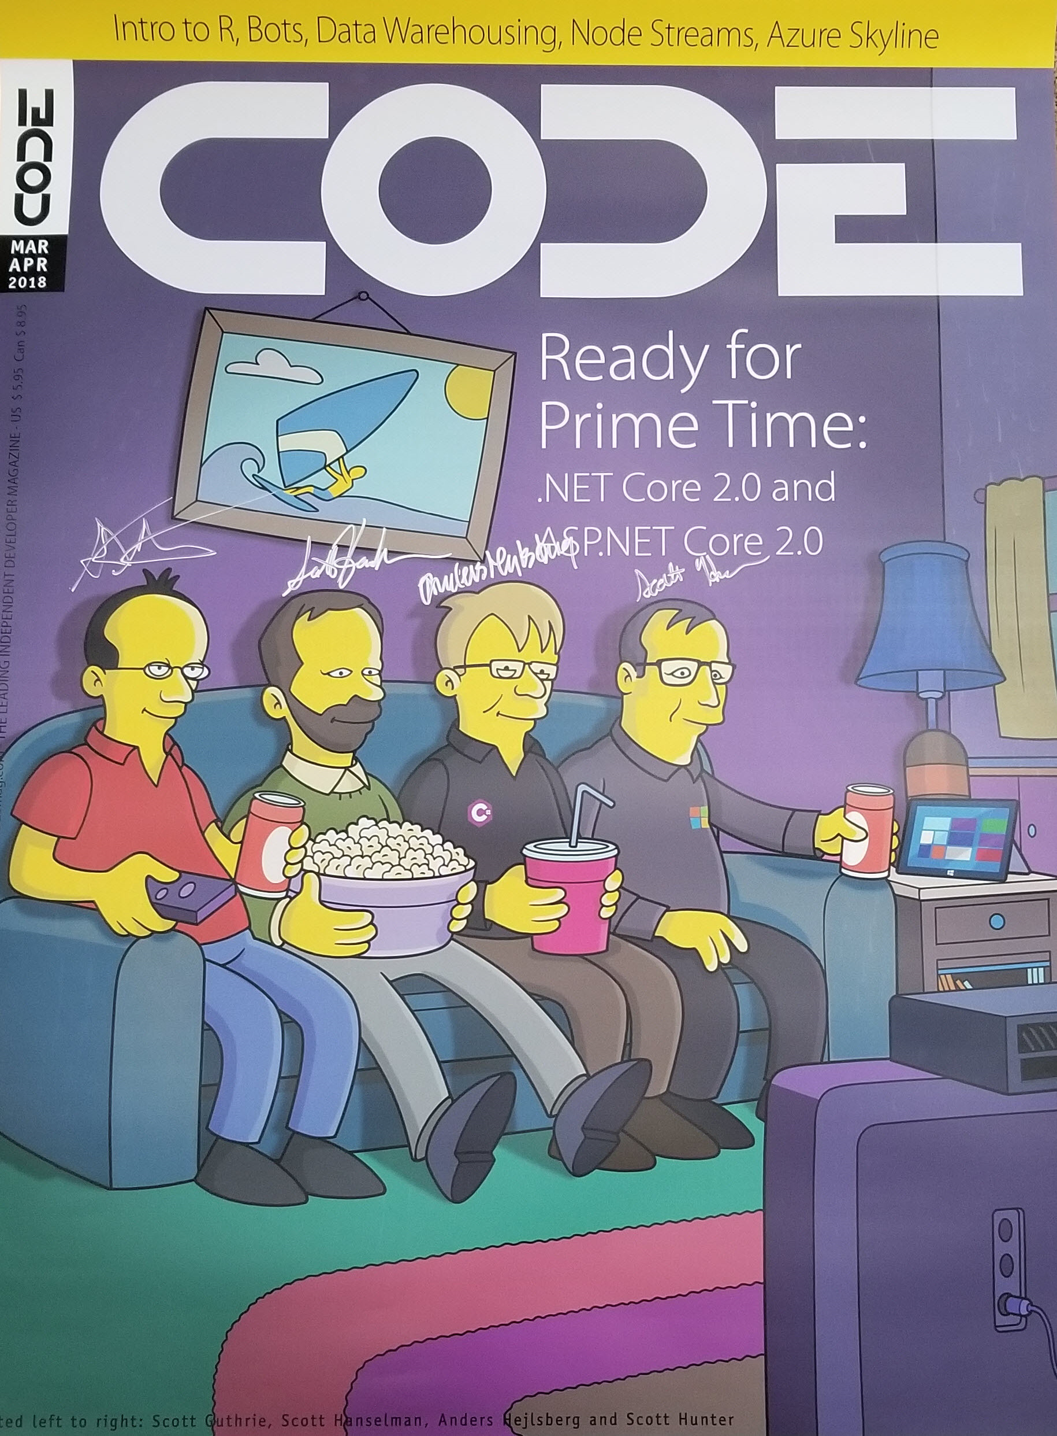
Download .NET Core 2.1 RC
https://aka.ms/DotNetCore21
And enter to win a poster from CODE Magazine signed by .NET rock stars Scott Guthrie, Scott Hanselman, Anders Hejlsberg, Scott Hunter

Slide 21
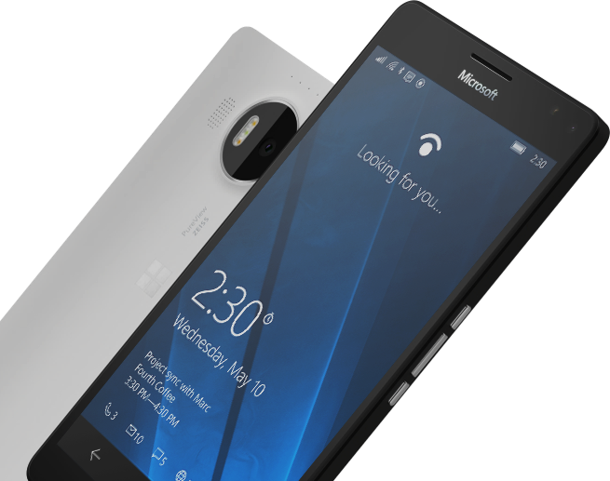
Please Complete An Evaluation Form for every session you attend. Your input is important!
#MSBuild

